Slide 1
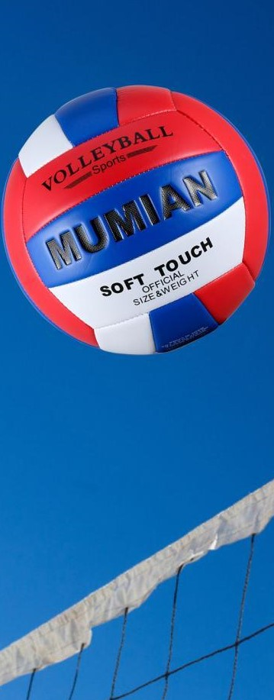
Westside High School
Sept. 19-23 Week At a Glance (WAG)

Slide 2
Coach Thomas
Rec. Games: Sept 19-23

Slide 3
Monday - Agenda
Sept 19
Standard:
PERG.1 The physically educated student demonstrates competency in a variety of motor skills and movement patterns.
a. Demonstrates competence while performing skills in a variety of recreational game settings and activities
b. Performs skills at a level of competence, which contributes to health-related fitness.
c. Demonstrates proper warm-up and cool-down protocol associated with different life time
sport physical activities.
PERG.3 The physically educated student demonstrates knowledge and skills to help achieve
and maintain a health-enhancing level of physical activity and fitness.
a. Maintains or improves fitness level by using the results of the Georgia Fitness Assessment
to guide changes in a personal program of physical activity.
b. Uses technologies to assess, enhance, and maintain health-related and skill-related fitness.
c. Analyzes the relationship between physical activity and longevity.
Personal and Social Behavior, Rules, Safety, and Etiquette
Learning Target
I can explain the purpose of the fitness gram
I can properly demonstrate each exercise for the fitness gram
Opening ( 10-15 mins)
10 minute Walk & Attendance
Work-session ( 20 - 25 mins)
Locker rooms (5 minutes)
Coach will explain the fitness gram & have class discussion of the purpose and various exercises performed
Teacher will demonstrate and explain each exercise and how to receive credit
Students will wear appropriate shoes and clothes to perform fitness gram assessments for the remainder of the week
Criteria for Success
Students can explain the fitness gram assessment process
Students can demonstrate the (curl-ups, push-ups, pacer test)
Closing ( 05 – 10 mins)
-locker room unlocked for 5 minutes
-students use remaining time to cool down & rehydrate if necessary

Slide 4
Tuesday - Agenda
Sept 20 Standard:
PERG.1 The physically educated student demonstrates competency in a variety of motor skills and movement patterns.
a. Demonstrates competence while performing skills in a variety of recreational game settings and activities
b. Performs skills at a level of competence, which contributes to health-related fitness.
c. Demonstrates proper warm-up and cool-down protocol associated with different life time
sport physical activities.
PERG.3 The physically educated student demonstrates knowledge and skills to help achieve
and maintain a health-enhancing level of physical activity and fitness.
a. Maintains or improves fitness level by using the results of the Georgia Fitness Assessment
to guide changes in a personal program of physical activity.
b. Uses technologies to assess, enhance, and maintain health-related and skill-related fitness.
c. Analyzes the relationship between physical activity and longevity.
Personal and Social Behavior, Rules, Safety, and Etiquette
Learning Target
Same as previous day
Opening ( 10-15 mins)
10 minute Walk & Attendance
Work-session ( 20 - 25 mins)
Criteria for Success
Teacher will call students to perform pacer test
Teacher will explain assessment process
Students will complete pacer test
Teacher will record scores based on students’ performance
Same as previous day
Closing ( 05 – 10 mins)
locker room unlocked for 5 minutes
-students use remaining time to cool down & rehydrate if necessary

Slide 5
Wednesday - Agenda
Sept 21 Standard:
PERG.1 The physically educated student demonstrates competency in a variety of motor skills and movement patterns.
a. Demonstrates competence while performing skills in a variety of recreational game settings and activities
b. Performs skills at a level of competence, which contributes to health-related fitness.
c. Demonstrates proper warm-up and cool-down protocol associated with different life time
sport physical activities.
PERG.3 The physically educated student demonstrates knowledge and skills to help achieve
and maintain a health-enhancing level of physical activity and fitness.
a. Maintains or improves fitness level by using the results of the Georgia Fitness Assessment
to guide changes in a personal program of physical activity.
b. Uses technologies to assess, enhance, and maintain health-related and skill-related fitness.
c. Analyzes the relationship between physical activity and longevity.
Personal and Social Behavior, Rules, Safety, and Etiquette
Learning Target
Same as previous day
Opening ( 10-15 mins)
10 minute Walk & Attendance
Work-session ( 20 - 25 mins)
Same as previous day for curl-ups
Criteria for Success
Same as previous day.
Closing ( 05 – 10 mins)
-locker room unlocked for 5 minutes
-students use remaining time to cool down & rehydrate if necessary

Slide 6
Thursday - Agenda
Sept 22 Standard:
PERG.1 The physically educated student demonstrates competency in a variety of motor skills and movement patterns.
a. Demonstrates competence while performing skills in a variety of recreational game settings and activities
b. Performs skills at a level of competence, which contributes to health-related fitness.
c. Demonstrates proper warm-up and cool-down protocol associated with different life time
sport physical activities.
PERG.3 The physically educated student demonstrates knowledge and skills to help achieve
and maintain a health-enhancing level of physical activity and fitness.
a. Maintains or improves fitness level by using the results of the Georgia Fitness Assessment
to guide changes in a personal program of physical activity.
b. Uses technologies to assess, enhance, and maintain health-related and skill-related fitness.
c. Analyzes the relationship between physical activity and longevity.
Personal and Social Behavior, Rules, Safety, and Etiquette
Learning Target
Same as previous day
Opening ( 10-15 mins)
5 minute Walk & Attendance
Work-session ( 20 - 25 mins)
Same as previous day for push-ups
Criteria for Success
Same as previous day
Closing ( 05 – 10 mins)
-locker room unlocked for 5 minutes
-students use remaining time to cool down & rehydrate if necessary

Slide 7
Friday - Agenda
Sept 23 Standard:
PERG.1 The physically educated student demonstrates competency in a variety of motor skills and movement patterns.
a. Demonstrates competence while performing skills in a variety of recreational game settings and activities
b. Performs skills at a level of competence, which contributes to health-related fitness.
c. Demonstrates proper warm-up and cool-down protocol associated with different life time
sport physical activities.
PERG.3 The physically educated student demonstrates knowledge and skills to help achieve
and maintain a health-enhancing level of physical activity and fitness.
a. Maintains or improves fitness level by using the results of the Georgia Fitness Assessment
to guide changes in a personal program of physical activity.
b. Uses technologies to assess, enhance, and maintain health-related and skill-related fitness.
c. Analyzes the relationship between physical activity and longevity.
Personal and Social Behavior, Rules, Safety, and Etiquette
Learning Target
Freestyle Friday
Opening ( 10-15 mins)
Attendance
Work-session ( 20 - 25 mins)
Students are able to engage in various activities/sports typically those that they are most interested
Teacher will conference will students and possibly make parent phone calls/contact as needed
Criteria for Success
I can demonstrate my understanding of the rules, procedures, and expectations by following them during class time and asking questions to teacher if necessary.
Closing ( 05 – 10 mins)
N/A

Slide 8
Resources
Pacer Test https://www.youtube.com/watch?v=9KPskEdeqx8
Curl ups https://www.youtube.com/watch?v=e6D6uRIfK7M
Push-ups https://www.youtube.com/watch?v=vFKk18SBJ5E

